Slide 1
Apache Kafka
Introduction

Slide 2
What is a Messaging System?
A Messaging System is responsible for transferring data from one application to another, so the applications can focus on data, but not worry about how to share it.
Distributed messaging is based on the concept of reliable message queuing. Messages are queued asynchronously between client applications and messaging system.
Messaging patterns:
point to point
publish-subscribe (pub-sub)

Slide 3
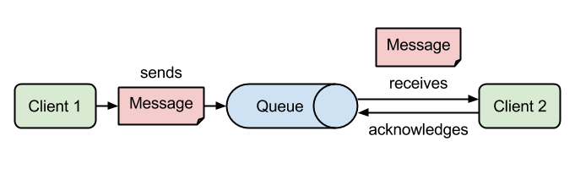
Point to Point Messaging System

Slide 4
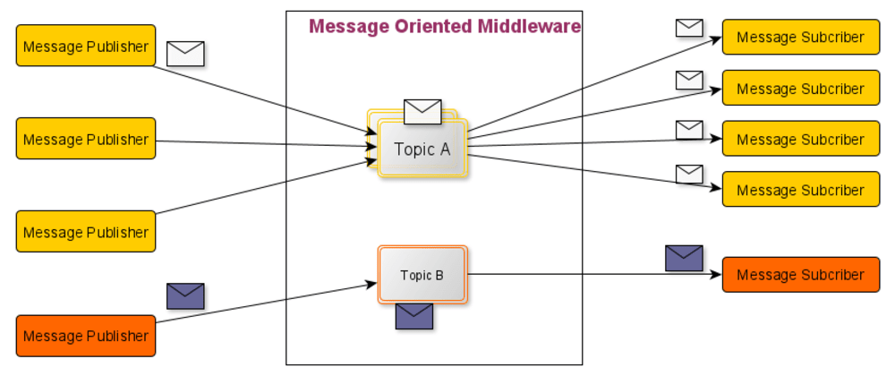
Publish-Subscribe Messaging System

Slide 5
What is Kafka?
Apache Kafka is an open-source distributed event streaming platform used by thousands of companies for high-performance data pipelines, streaming analytics, data integration, and mission-critical applications.
Kafka is suitable for both offline and online message consumption. Kafka messages are persisted on the disk and replicated within the cluster to prevent data loss.
Kafka is built on top of the ZooKeeper synchronization service. It integrates very well with Apache Storm and Spark for real-time streaming data analysis.

Slide 6
Benefits
Kafka
Reliability
Scalability
Durability
Performance

Slide 7
Use Cases
Metrics
Log Aggregation Solution
Stream Processing

Slide 8
Need for Kafka
Kafka is a unified platform for handling all the real-time data feeds. Kafka supports low latency message delivery and gives guarantee for fault tolerance in the presence of machine failures.
It has the ability to handle a large number of diverse consumers. Kafka is very fast, performs 2 million writes/sec. Kafka persists all data to the disk, which essentially means that all the writes go to the page cache of the OS (RAM). This makes it very efficient to transfer data from page cache to a network socket.

Slide 9
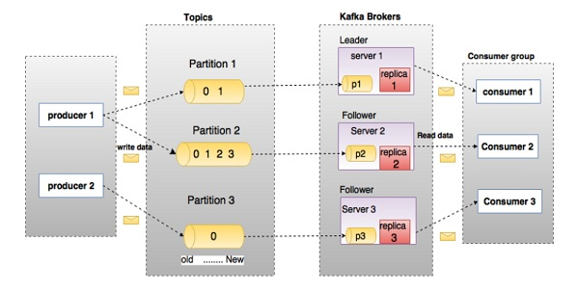
Apache Kafka - Fundamentals

Slide 10
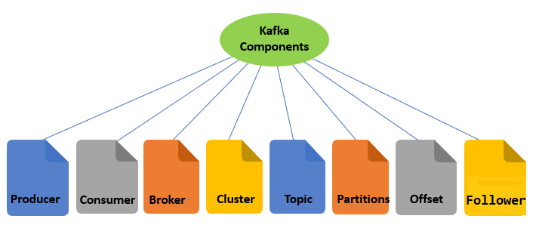
Components

Slide 11
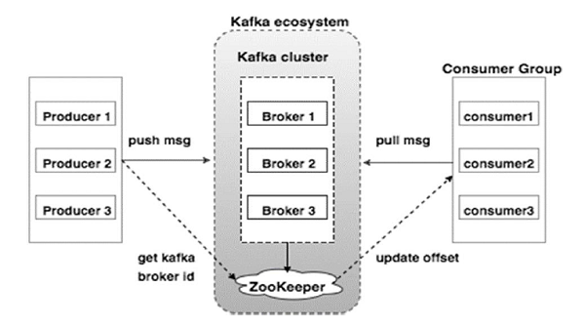
Cluster Architecture

Slide 12
How Apache Kafka Works?
Workflow of Pub-Sub Messaging
Workflow of Queue Messaging / Consumer Group
Role of ZooKeeper

Slide 13
Let’s install the Kafka

